Slide 1
face recognition Attendance Management System
PROJECT PRESENTATION ON

Slide 2
ABstracT
In today's almost the whole world is connected to the Internet. All the digital devices are connected to the Internet which infuses work easier for the people. Nowadays, many of the devices are being developed using the Internet of Things (IoT), computing, image processing, and machine learning. The system had been developed for appraise the attendance of the student and recognition of the student faces for marking up the attendance. The system is enacted to form a classroom attendance system that uses the concept of face recognition as today's manual attendance systems become more time-consuming and cumbersome to keep up properly. A database of all the students with their details is stored in the firebase cloud, and attendance is recorded when the face that is recognized by the system is available in the database which had been done through training of the images. The system is designed and developed in python language .It has its own face recognition method and listening features using the (LBPH) Algorithm" within the project of the OpenCV library. It uses "Haar Cascade Classifier". It uses Tkinter for GUI and Firebase for the database.
Keywords: Face Recognition, Face Detection, Haar-Cascade Classifier, Local Binary Pattern Histogram (LBPH), Tkinter, OpenCV, Firebase Cloud

Slide 3
Problem Definition
The use of digital paper based manual attendance system by giving the lecturers attendance sheet to check whether the student is attended the class or not. For the sake of this system many problems has faced that manual system.
.
The teachers need to hire student attendance sheet Excel to collect and file student attendance is lost.
You may receive false attendance data from your employees when you track attendance manually.
It is a time consuming process in a class.
Attendance records are not communicated efficiently.

Slide 4



Objectives
Spots the presence of attending students and providing the timing of the attendance marked.
Capable of storing maximum records and no need of manual attendance
Only students are responsible for making attendance of their own

Slide 5
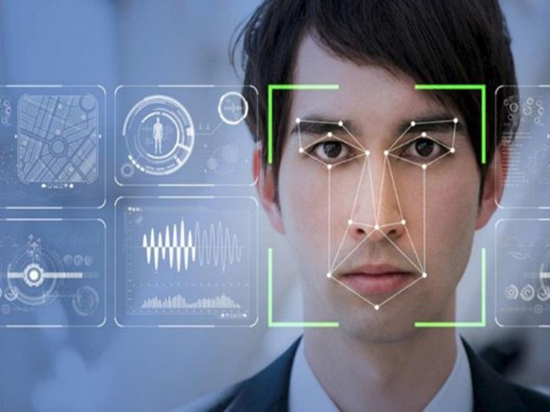
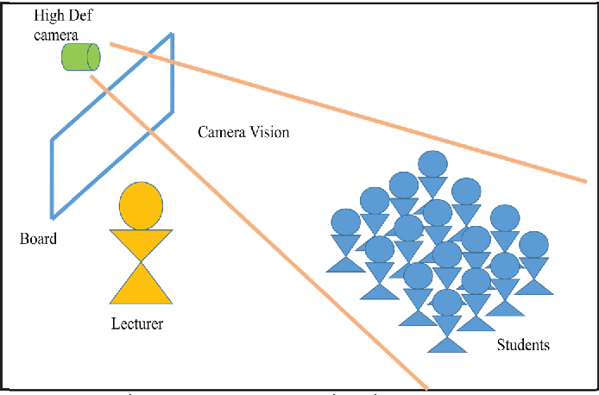
Introduction
Attendance Management System Using Face Recognition is a system developed for daily student attendance in schools, colleges and institutes. Face recognition could be a trending technology almost utilized in every area from security, research, automation and lots of more things. and that we are aiming and targeting on the attendance of the scholars by applying OpenCV and a few python’s inbuilt functionality. we've got also used text to speech library.

Slide 6
Technology Used
Machine learning - LBPH algorithm, haarcascade classifier
Image processing - python open CV library
GUI – tkinter library
Database – firebase cloud real -time database and authentication
Cloud technology – paas (hereoku application)

Slide 7
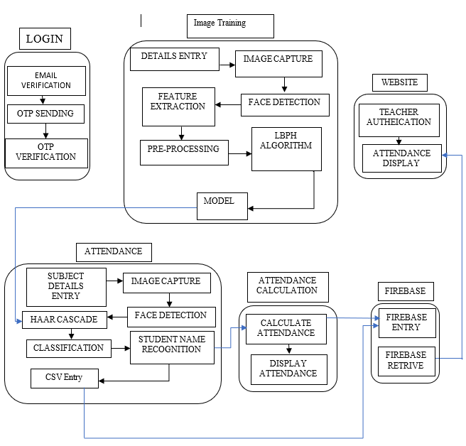
SYSTEM ARCHITECTURE
The system architecture process is developed where the concepts that will be the backbone of the system and where the actual system is developed. It describes the conceptual model that shows the structure and behavior of the proposed system or of an existing system. The architecture includes the technical framework, end user requirements, and a list of the system components.

Slide 8
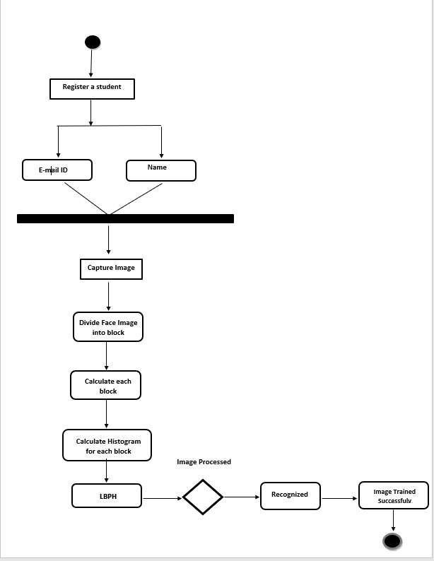
training Image
Training data is also known as a training set, training dataset or learning set. This module is used in this project from capturing the image and training of the image to recognize the faces of the students given to train.

Slide 9
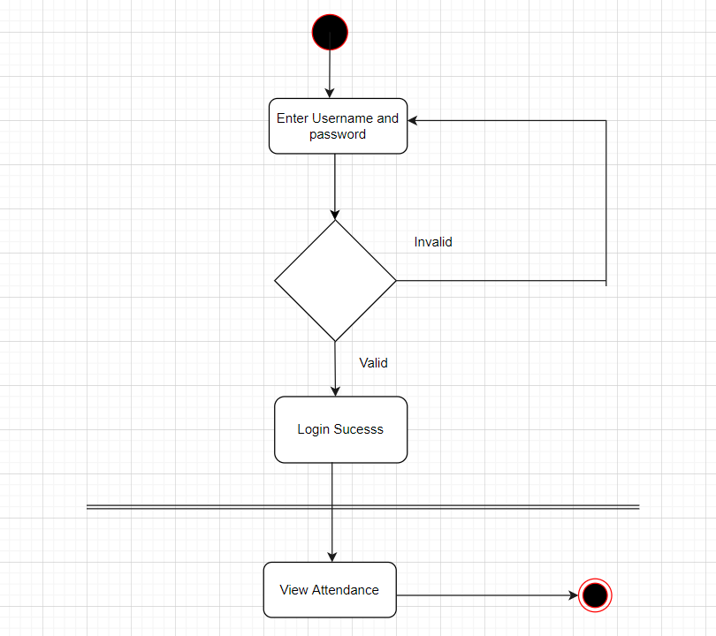
WEBSITE
The user who are willing to login through website must provide login details for accessing the website system. The website is designed using HTML, Tailwind CSS and JavaScript. The website demonstrations the databases stored in the system in the tabular format. The link of our website is:
https://attendance-mgnt-system.herokuapp.com/

Slide 10
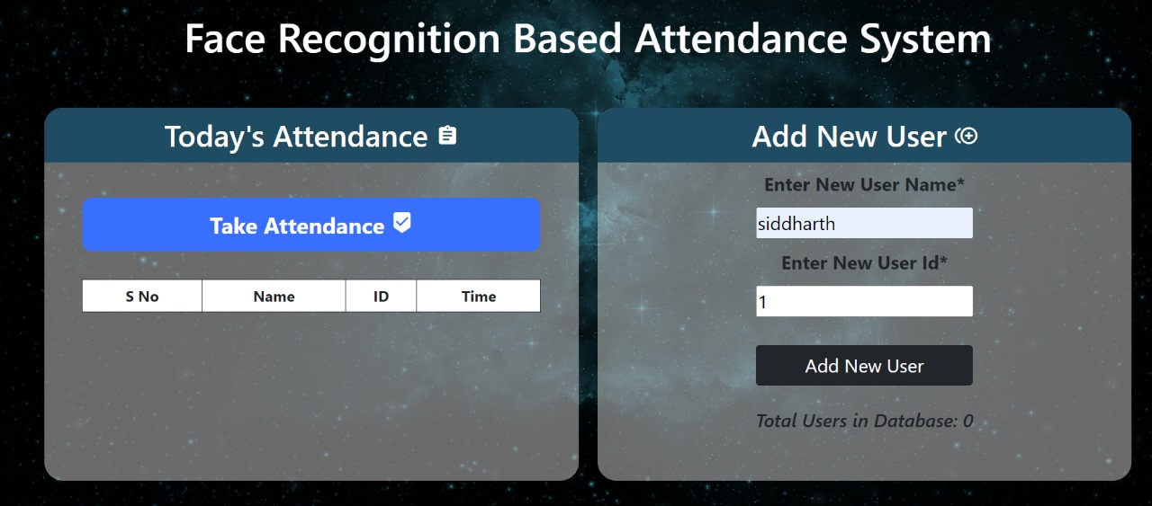
RESULT OBTAINED
LOGIN SNAP OF SYSTEM

Slide 11
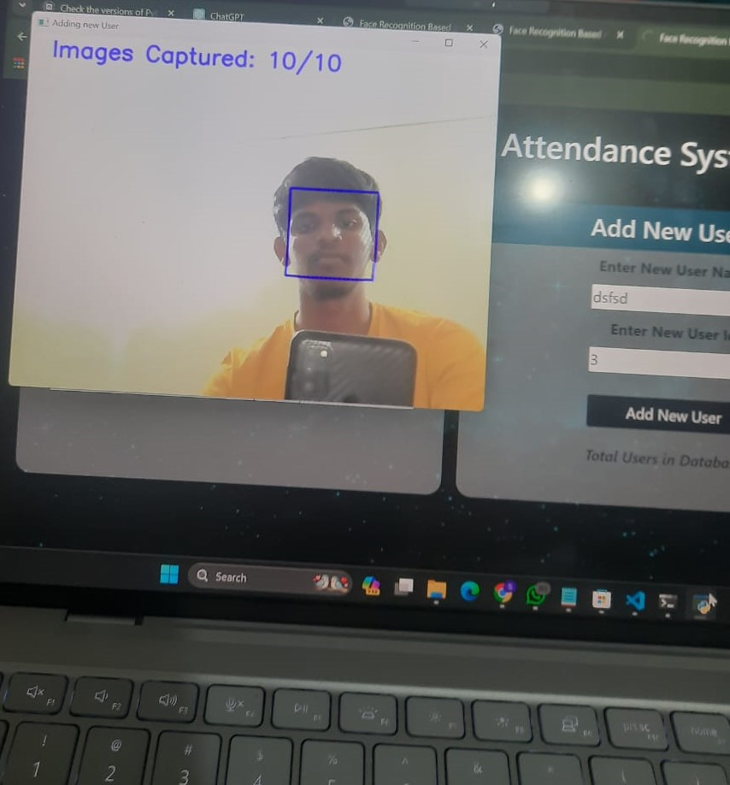
TEST CASES

Slide 12
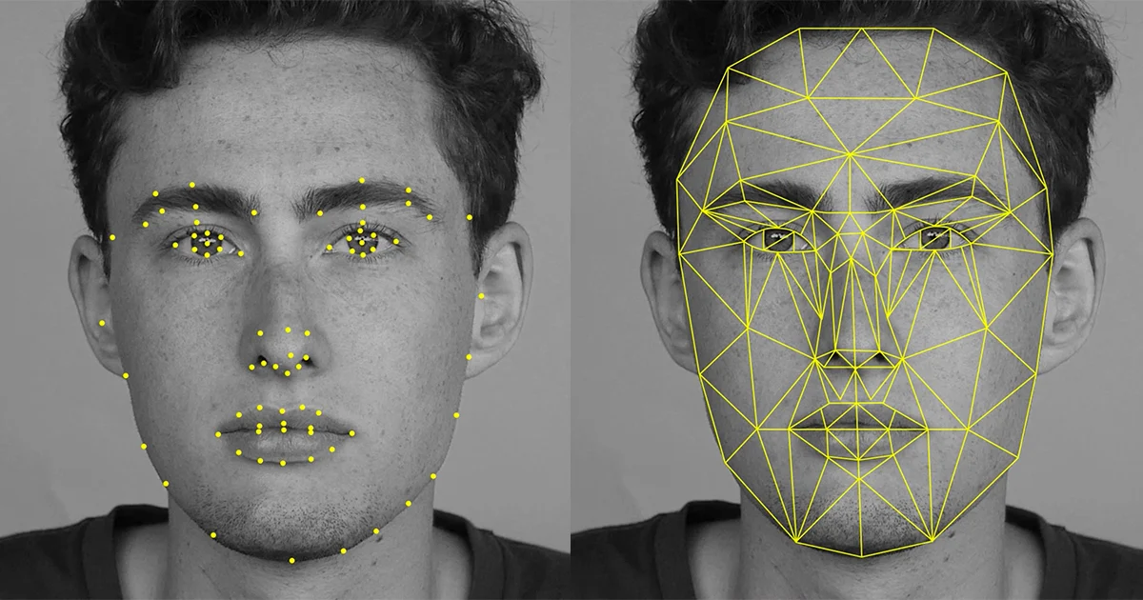
REGISTER FACE SNAP

Slide 13
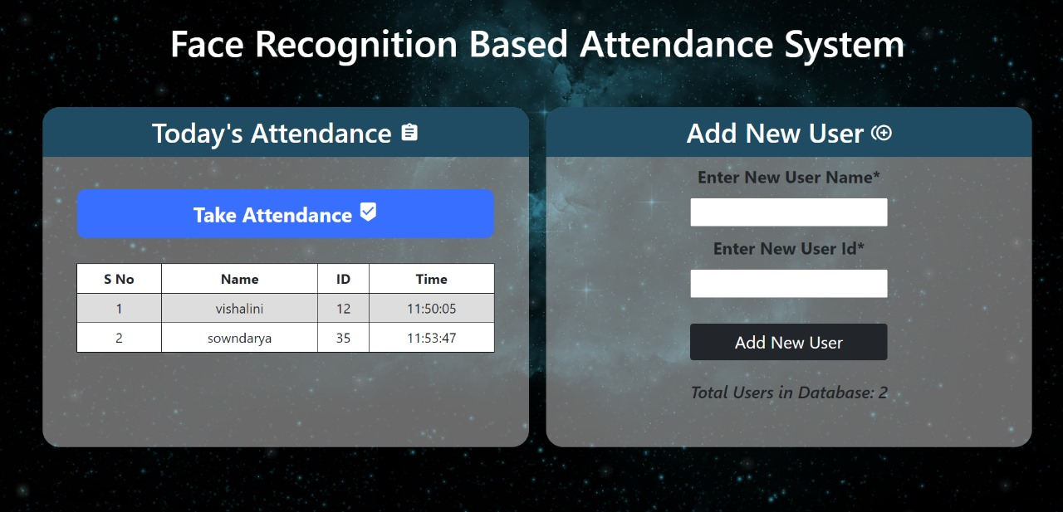
ATTENDANCE DISPLAY ON WEBSITE

Slide 14
Conclusion AND FUTURE USE
This system is very simple in term of calculation and improve speed as well. It required only one scanning without any need to a complicated analysis. Face recognition technology have been associated generally with very cost top secure systems. Today the core technologies have evolved and the cost of equipment is going down dramatically due to the integration and the increasing process power. Certain systems of face recognition technology are now cost effective, reliable and highly accurate. That why attendance management system using face recognition helps us in any school, colleges, and any kind of company as well.
We can use this technology in other ways as well, further expanding the monitoring to track specific students on campus in real-time. We can also work with recorded videos instead of taking pictures. But some time period is kept for recording the images, because if the recording is done continuously then the load on the database increases. Future work is to improve the algorithm's detection rate when a person has unintentional changes such as shaving the head, using scarves and beards.

Slide 15
THANKS!

